Slide 1
Trauma scoring system
By: Wubayehu Amare (MSc, lecturer)

Slide 2
Trauma score system
It is a system used to assess the severity of trauma in patients, particularly in emergency and critical care settings.
It helps medical professionals determine the level of care required and predict outcomes.
A systematic approach to assess the severity of injuries.
Utilizes specific criteria to quantify trauma and predict outcomes.

Slide 3
Cont…
Scoring system can provide
The ability to predict outcome from trauma (mortality)
Facilitate rational pre-hospital triage decision
An aid for the clinical management of patient
A tool for comparative audit
A mechanism to decide resource allocation
Objective information for end of life decision making

Slide 4
: Classification of Injury Scoring Systems
Anatomical Scoring Systems:
Focus on the location and severity of injuries.
Examples: Abbreviated Injury Scale (AIS), Injury Severity Score (ISS).
Physiological Scoring Systems:
Based on vital signs and physiological parameters.
Examples: Glasgow Coma Scale (GCS), Trauma Score (TS).
Combined Scoring Systems:
Utilize both anatomical and physiological parameters for a comprehensive assessment.
Examples: Revised Trauma Score (RTS), Trauma Injury Severity Score (TRISS).

Slide 5
Anatomical Scoring Systems
Anatomical scoring systems assess trauma based on the specific injuries sustained and their severity.
These systems help in understanding the impact of injuries on patient outcomes, guiding clinical decision-making, and facilitating communication among healthcare providers.
Focus on Injury Location: These systems categorize injuries based on the anatomical regions affected (e.g., head, thorax, abdomen, extremities).
Severity Assessment: They evaluate the severity of injuries, often assigning scores that reflect the degree of damage to various body parts.

Slide 6
Abbreviated Injury Scale (AIS):
A coding system that assigns a score from 1 to 6 for individual injuries based on their severity, where:
0 - no injury
1 - minor
2 - moderate
3 - severe (not life-threatening)
4 - severe (life-threatening, survival probable)
5 - severe (critical, survival uncertain)
6 - maximal, possibly fatal
Use: Commonly used in trauma research and for calculating the Injury Severity Score (ISS).

Slide 7
cont..
was developed by engineers to rate and compare blunt injuries from road vehicle accidents and has undergone several modifications since its introduction in 1971.
It represents the threat to life associated with the injury rather than the comprehensive assessment of the severity of the injury
AIS is one of the most common anatomic scales for traumatic injuries.

Slide 8
Cont..
Score | Description | Example
1 | Minor | Abrasions or minor lacerations on the skin.
2 | Moderate | Fracture of a distal radius (wrist fracture).
3 | severe (not life-threatening) | Pneumothorax requiring chest tube placement.
4 | Severe (life-threatening, survival probable) | Liver laceration requiring surgical intervention.
5 | Critical (critical, survival uncertain) | Traumatic brain injury with significant haemorrhage.
6 | Unsalvageable | Complete spinal cord injury at cervical level.

Slide 9
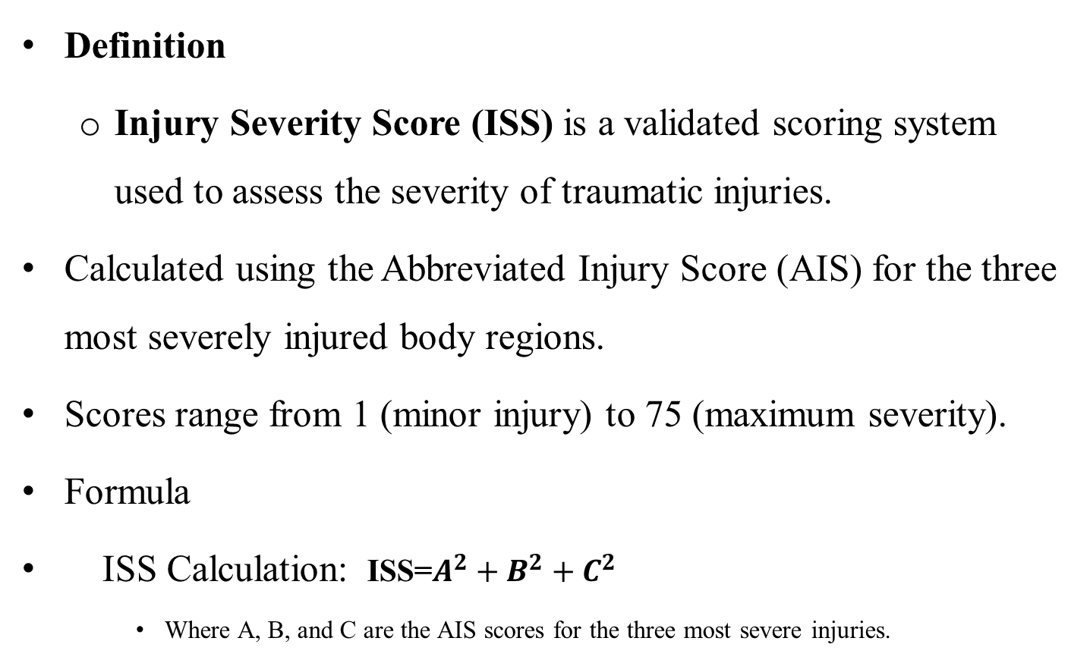
Injury Severity Score (ISS)
Definition
Injury Severity Score (ISS) is a validated scoring system used to assess the severity of traumatic injuries.
Calculated using the Abbreviated Injury Score (AIS) for the three most severely injured body regions.
Scores range from 1 (minor injury) to 75 (maximum severity).
Formula
ISS Calculation: ISS=$A^{2}+B^{2}+C^{2}$
Where A, B, and C are the AIS scores for the three most severe injuries.

Slide 10
ISS Body Regions & Injury Assignments:
Head or Neck Injuries
Involves the brain, cervical spine, skull, and cervical spine fractures.
Also includes asphyxia and suffocation.
Facial Injuries
Involves the mouth, ears, nose, and facial bones.
Chest Injuries
Includes internal organ injuries (lungs, heart, etc.), drowning, and inhalation injury.
Also covers injuries to the diaphragm, rib cage, and thoracic spine.

Slide 11
Cont..
Abdominal or Pelvic Contents Injuries
Includes injuries to internal organs (liver, spleen, intestines) and the lumbar spine.
Extremities or Pelvic Girdle Injuries
Includes sprains, fractures, dislocations, and amputations.
External and Other Trauma Injuries
Includes skin injuries (lacerations, contusions, abrasions, burns), regardless of their location.
Other events such as electrical injury, frostbite, hypothermia, and whole-body injuries (e.g., from explosions) are also assigned here.

Slide 12
Body region | Injury | AIS code | Highest AIS | ISS
Head or neck | Cerebral contusion (NFS) Internal carotid artery transection (neck) | 3 4 | 4 | 16
Face | Closed fractured nose | 1 | 1
Chest | Rib fractures left side, ribs 3 – 4 | 2 | 2
Abdomen | Retroperitoneal haematoma | 2 | 2 | 4
Extremities | Fractured femur (NFS) | 3 | 3 | 9
External | Abrasions (NFS) | 1 | 1
 |  |  |  | ISS = 29

Slide 13
Cont..
Purpose
Widely utilized in trauma research and clinical setting
Helps predict mortality, morbidity, and overall patient outcomes.
Assists in resource allocation and treatment planning.
A score of <16 generally indicates mild injury, ISS >16 mortality rate of 10%

Slide 14
Cont..
Interpretation:
Minor Injury: ISS ≤ 8
Moderate Injury: ISS 9–15
Severe Injury: ISS 16–24
Critical Injury: ISS ≥ 25

Slide 15
Example
A 32-year-old male was involved in a high-speed motor vehicle collision arrival at the emergency department, he presented with confusion and difficulty breathing. A CT scan revealed an intracranial haemorrhage. Physical examination showed bruising and tenderness in the chest, with chest X-rays indicating a rib fracture and possible pulmonary contusion. Additionally, significant swelling and pain were noted in the right thigh, where X-rays confirmed a mid-shaft fracture of the femur, but neurovascular status was intact. What is the ISS score of this patient and its clinical implication?
Head Trauma: AIS = 4 (Intracranial hemorrhage)
Chest Trauma: AIS = 3 (Rib fracture and possible pulmonary contusion)
Femur Fracture: AIS = 2 (Mid-shaft fracture of the femur)

Slide 16
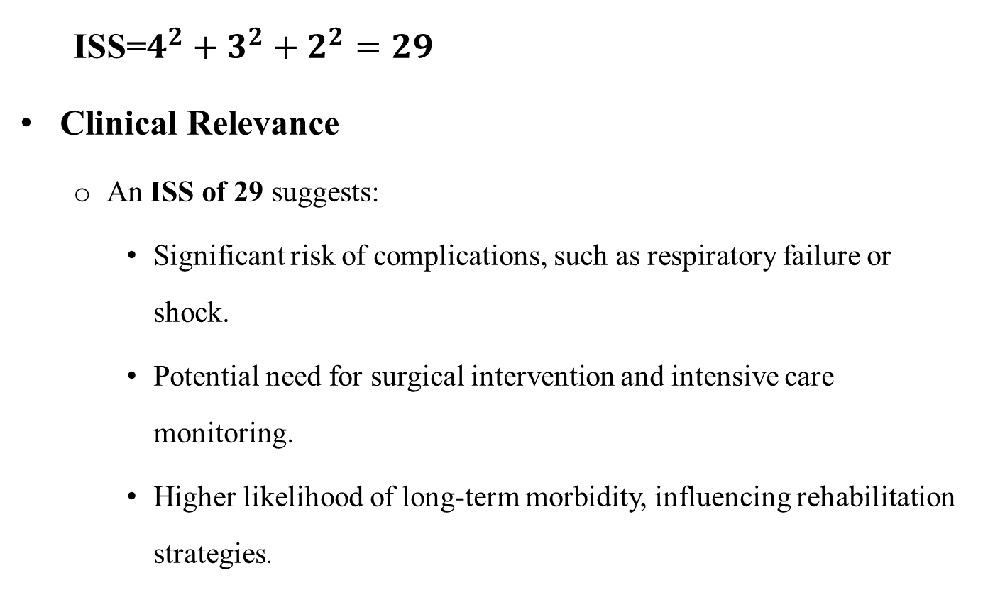
Cont..
ISS=$4^{2}+3^{2}+2^{2}=29$
Clinical Relevance
An ISS of 29 suggests:
Significant risk of complications, such as respiratory failure or shock.
Potential need for surgical intervention and intensive care monitoring.
Higher likelihood of long-term morbidity, influencing rehabilitation strategies.

Slide 17
NISS (New Injury Severity Score)
Modified Calculation:
The NISS also calculates the severity of the three most severe injuries;
the difference is that it does not require the injuries to be from different body regions.
This means that, in the NISS, it is possible to have multiple injuries within the same anatomical region (e.g., head, chest, or abdomen) that are considered in the score.

Slide 18
Cont..
Like the ISS, the NISS sums the squares of the AIS values of the three most severe injuries.
The key difference is that NISS can incorporate multiple severe injuries within a single body region, which may better reflect the overall severity of trauma.
For example, if a person has two severe head injuries (both AIS 4), and one severe abdominal injury (AIS 3), the NISS will square each of these injuries (4² + 4² + 3² = 16 + 16 + 9 = 41), whereas the ISS would consider only the highest AIS from each body region.

Slide 19
Cont..
interpretation:
NISS ≤ 8: Minor injuries
NISS ≥ 25: High likelihood of mortality
It is a more accurate predictor of mortality compared to the ISS.

Slide 20
Physiological Scoring Systems
Definition:
Physiological scoring systems assess a patient’s condition based on vital signs and other physiological parameters, providing critical information for triage, management, and outcome prediction in trauma and critical care.

Slide 21
The Glasgow Coma Scale
GSC is an essential tool for assessing the level of consciousness in trauma patients, particularly in cases of traumatic brain injury (TBI).
It quantifies the severity of head injuries by evaluating three key areas:
Eye opening,
Verbal response, and
Motor response

Slide 22
cont
The GSC is not only used at the initial assessment; it is also employed for on going evaluations of the patient’s condition.
Regular monitoring helps track changes in consciousness and can Indicate improvements or deterioration over time.
It provides a quick, standardized measure to determine the severity of the brain injury.
The total score ranges from 3 (deep coma or death) to 15 (fully alert and oriented).
This scoring system provides valuable insight into the patient's neurological status and guides clinical decision-making.

Slide 23
Scoring System
Eye Opening (1-4 points)
4: Spontaneous
3: To speech
2: To pain
1: None
Verbal Response (1-5 points)
5: Oriented
4: Confused
3: Inappropriate words
2: Incomprehensible sounds
1: None
Motor Response (1-6 points)
6: Obeys commands
5: Localizes pain
4: Withdraws from pain
3: Abnormal flexion
2: Abnormal extension
1: None

Slide 24
Cont..
Example:
A 35-year-old male is admitted after a car accident. He is unresponsive to verbal commands but opens his eyes to painful stimuli and moves his limbs.
Assessment:
Eye opening: 2 (opens eyes in response to pain)
Verbal response: 2 (inappropriate words)
Motor response: 4 (withdraws from pain)
Total GCS = 2 (eye) + 2 (verbal) + 4 (motor) = 8
Interpretation: The patient has a severe brain injury (GCS ≤ 8), which suggests a high risk of neurological deterioration and warrants urgent intervention.

Slide 25
Revised Trauma Score
The RTS incorporates three items: GCS, RR and SBP
It is calculated using the coded values (0–4)

Slide 26
Cont…
Calculation
Glasgow coma scale score + systolic blood pressure score + respiratory rate score
Interpretation
lower score indicates higher severity
RTS <4 proposed for transfer to trauma center
Pros
useful during triage to determine which patients need to be transported to a trauma center
Cons
can underestimate injury severity in patients injured in one system

Slide 27
Cont..
RTS Classification:
Score Range: 0 to 12
Higher RTS indicates better physiological status.
Interpretation:
RTS > 12: Low risk of mortality.
RTS < 12: Higher risk of mortality and need for advanced intervention.

Slide 28
Cont..
Example:
A 40-year-old male is brought in after a fall from a building. His vital signs and GCS are as follows:
GCS: 11, SBP: 90/55 mmHg , RR: 18b/min
RTS Calculation:
GCS score: 11 → RTS points = 4
SBP: 90 mmHg → RTS points = 3
RR: 18 breaths/min → RTS points = 4
Total RTS = 4 (GCS) + 3 (SBP) + 4 (RR) = 11
Interpretation: The patient has an RTS of 11, suggesting a moderate risk of mortality. Although the GCS is slightly depressed, the patient’s vital signs show signs of stability, but close monitoring is essential.

Slide 29
Triage
Triage is the process of determining the severity of a patient’s condition.
Patients with the most severe emergencies receive immediate treatment.
priority level based on your medical history and current condition according to the following scale: Level 1 – Resuscitation (immediate life-saving intervention); Level 2 – Emergency; Level 3 – Urgent; Level 4 – Semi-urgent; Level 5 – Non-urgent

Slide 30
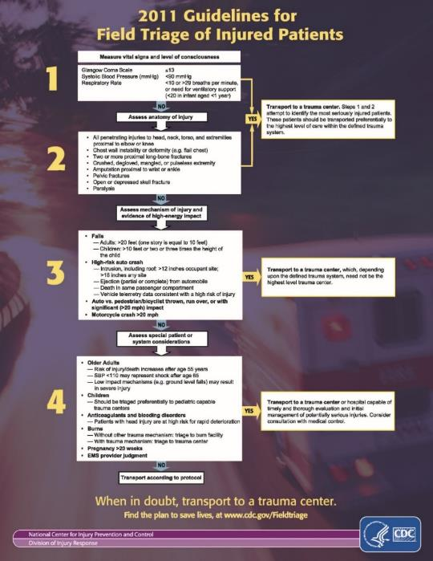
2011 Guideline
Assess vital signs & level of consciousness
Assess anatomy of injury
Assess mechanism of injury & evidence of high energy impact
Assess special patient or system considerations
Notes:
Should be familiar to all!

Slide 31


Field Triage Decision Scheme
Measure Vital Sign and level of consciousness
GCS =< 13
SBP < 90 mmhg
RR < 10 or > 29 bpm or [< 20, < 1year] or need ventilator support
Step 1
No
Yes
Assess anatomy of injury
No
Yes
Yes
Step 2
No

Slide 32
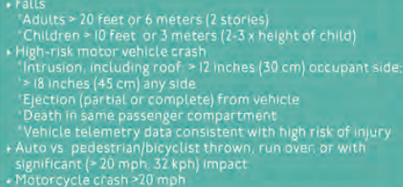
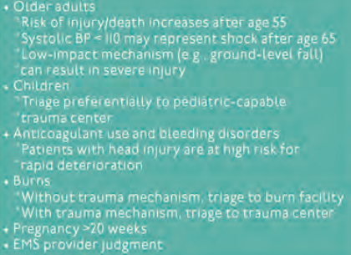

.
FTDS cont.
Step 3
No

Slide 33
Any questions???

